Slide 1
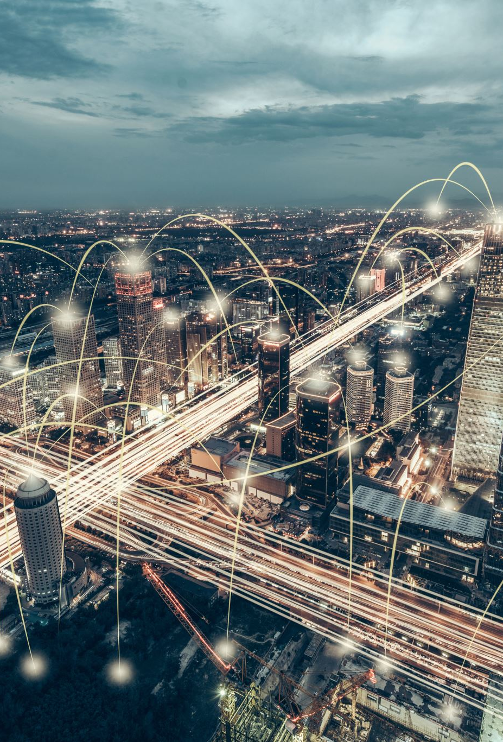
APPLICATION of IOT in Real World

Slide 2
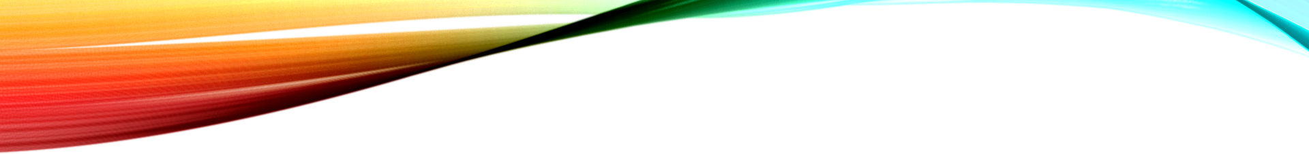

Top 9 applications
Agriculture
Environment
Smart Home
Health Care
Smart Cities
Safe Driving
Waste management
Industrial issues
Supply chain

Slide 3
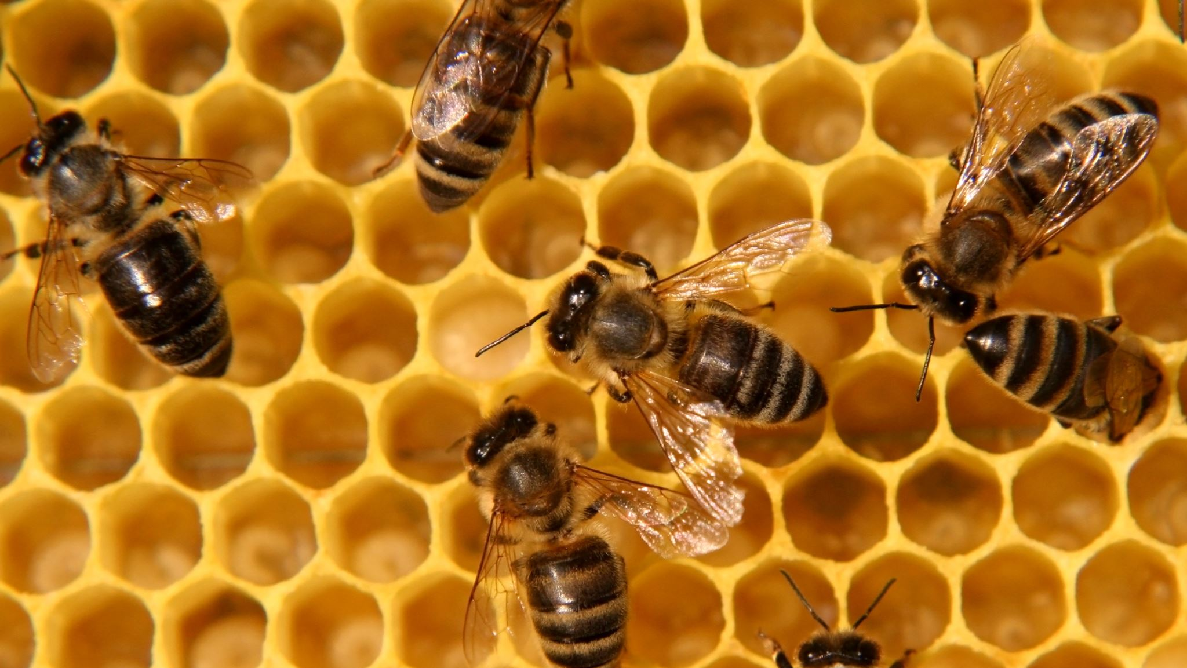
“Problem”
Honey Bees are facing a threat in this polluted world. Climate change is affecting them as well.

Slide 4
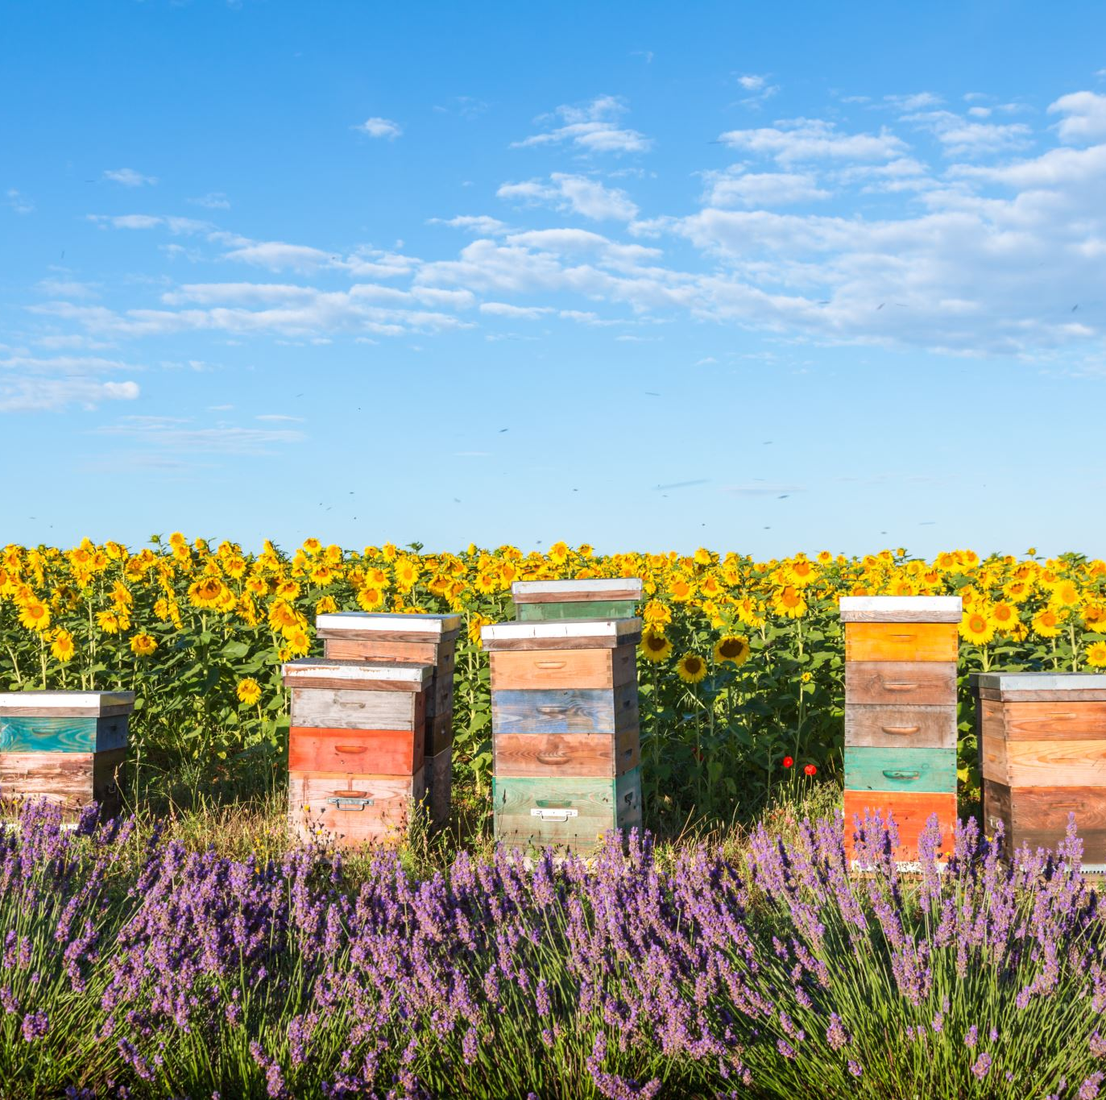
“Solution”
By implanting IoT devices, beekeepers can take better charge of preserving hives.

Slide 5
how….?
Using IoT with connected sensors, it is possible to keep track of the hive temperature, amount of food present in the hives and also, the pollen collection.

Slide 6
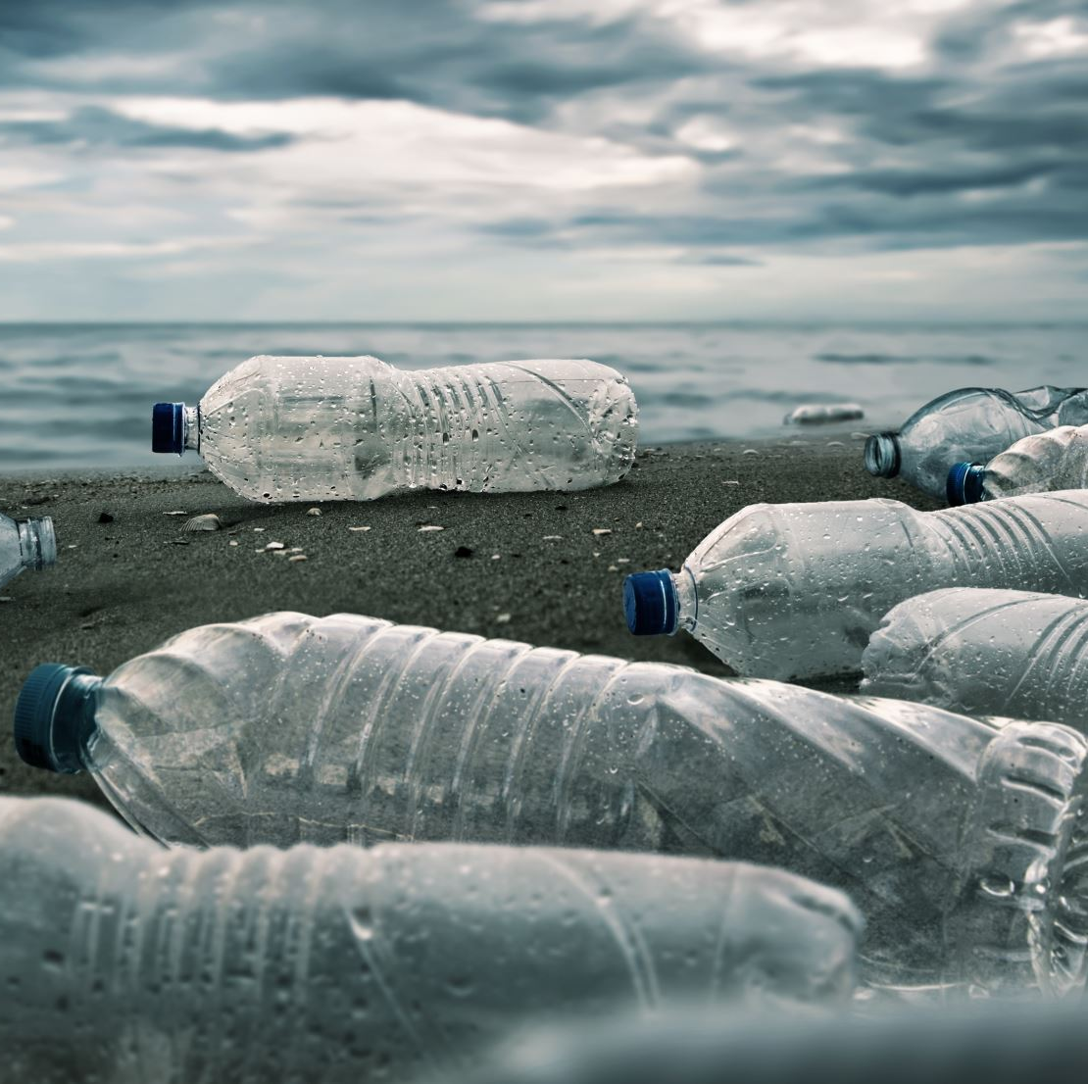
Moreover…
IoT can be also used in waste management also, helping us take better care of our environment.

Slide 7
disadvantages of the internet of things.
Security is one of the biggest challenges in the world of IoT. Users may share sensitive data among objects and risk a breach, but they should be aware of the security risks of the Internet and learn how to avoid them
Therefore, the intellectual property of IoT devices is a highly controversial issue. We should pay more attention to security, privacy, and intellectual property when we use the Internet of Things.

